Slide 1

2021-22 Governor’s Budget Proposal
Board Update
San Ramon Valley Unified
January 26, 2021

Slide 2
Dr. Malloy Overview and Context
Governor’s proposed budget shares good news from the state
First step in a multi-step process, including May Revise and Legislature passing the State Budget by or before July 1
Good news, but not without some questions
Overview and take Board questions
1
Notes:
Dr. John – These slide that he wants to present

Slide 3
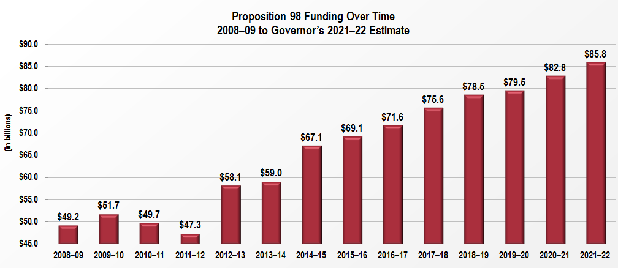
Proposition 98 Funding
2

Slide 4
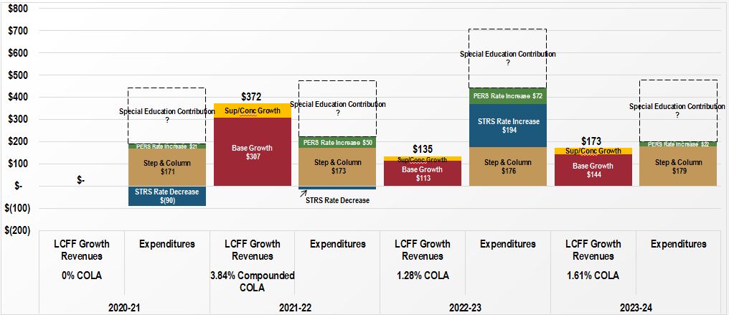
Revenues versus Expenses
3

Slide 5
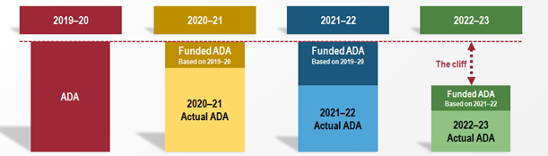
Enrollment (Average Daily Attendance) Consideration
Gap
4

Slide 6
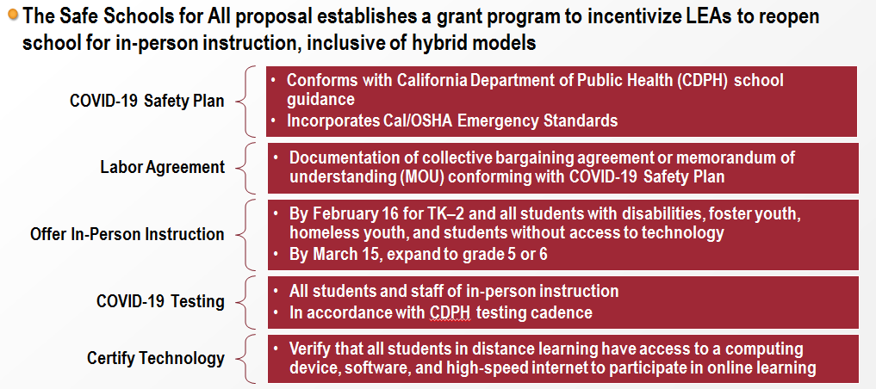


Governor Newsom’s
Safe Schools For All Plan
5

Slide 7
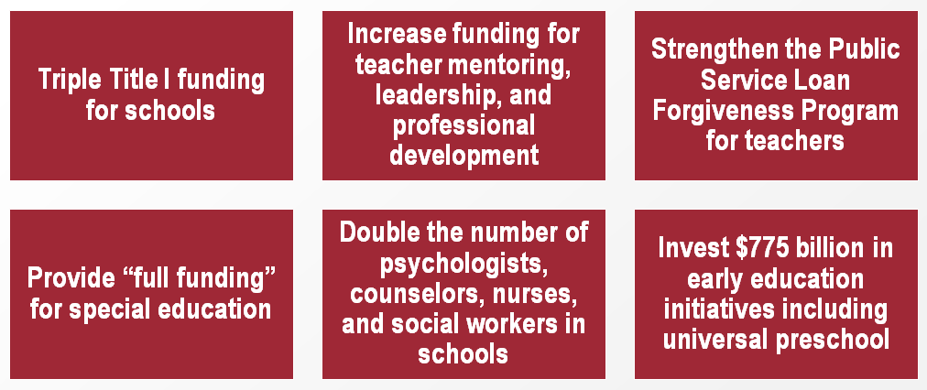
President Biden’s Proposed Education Agenda
6

Slide 8
Process and Consideration
January – Governor’s Proposal
  State revenue is welcome relief
  Prop 98 Guarantee to Public Education
  Pointed questions about Public Education dollars allocated to cover testing/public health costs
May – Governor’s May Revise
July – State Budget from Legislature
7

Slide 9
Dr. Malloy’s Next Steps
Continue to Monitor
Key Constituents
8

